Slide 1
UNIT ONE- Part Three

Slide 2
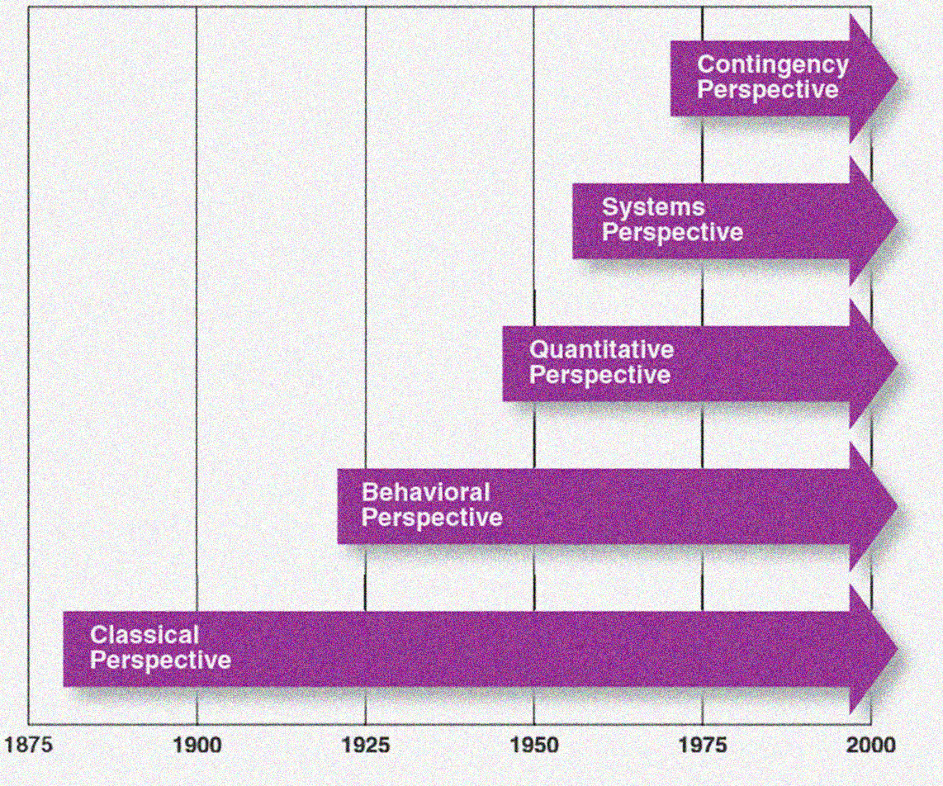
EVOLUTION OF MANAGEMENT THOUGHT

Slide 3
DIFFERENT APPROACHES
CLASSICAL
SCIENTIFIC
BUREAUCRATIC
BEHAVIOURAL
GROUP INFLUENCES
MODERN
SYSTEM
CONTINGENCY
ADMINISTRATIVE
MASLOW’S NEED THEORY
THEORY X AND THEORY Y
HAWTHORNE STUDIES

Slide 4
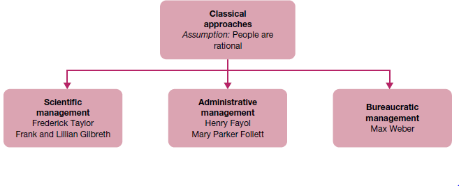

Slide 5
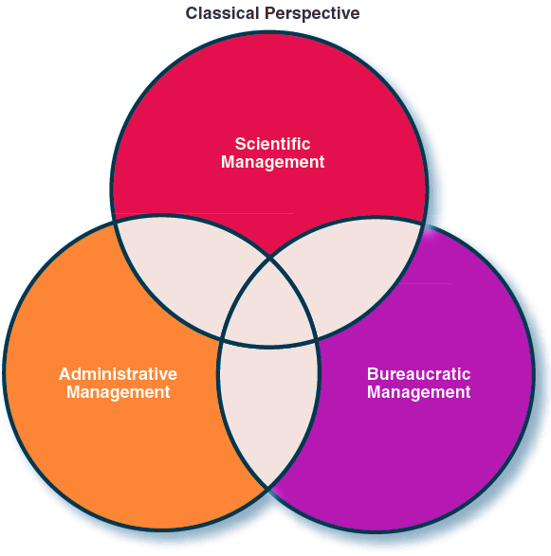
CLASSICAL APPROACH
Focuses on the individual worker’s productivity
Focuses on the overall organizational system
Focuses on the functions of management

Slide 6
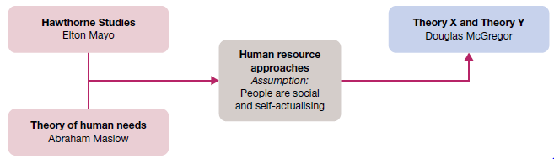
Behavioural approaches to management

Slide 7
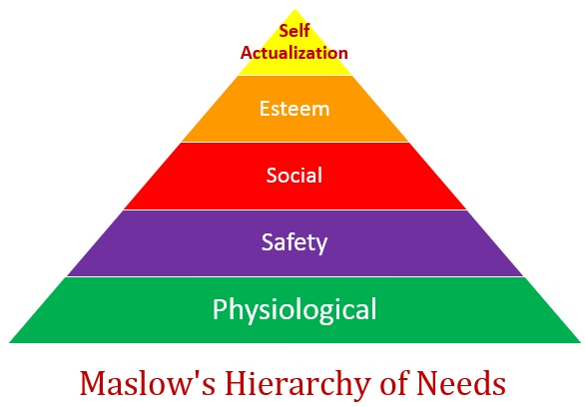

Slide 8




Slide 9





Slide 10






Slide 11


Slide 12




Slide 13
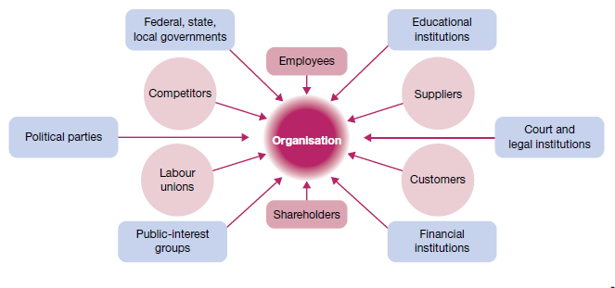
Environmental Factors- Internal and External Factors

Slide 14


Slide 15


Slide 16


